Slide 1
The saturation state control on calcium carbonate pebble reactivity in clastic sea beaches (Marina di Pisa, Italy)
Riccardo Petrini
Lisa Ghezzi
Claudia Casacchia

Slide 2
General considerations
Marble pebbles are mostly made by calcium carbonate minerals (calcite, CaCO₃)
Surface seawater is apparently strongly supersaturated with calcite
This means that calcite mineral should precipitate extensively from seawater
Actually this does not happen due to kinetics inhibitors
It might however be expected that seawater was not able to dissolve calcite and calcite-bearing rocks such as marbles
This is not necessarily true

Slide 3
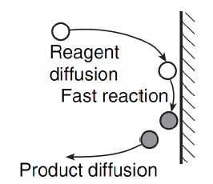
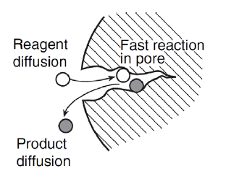
Theory of calcite dissolution reaction in aqueous solution and seawater
The dissolution of calcite mineral in water is a heterogeneous reaction, where a solid reacts with a liquid
The rate of a heterogeneous reaction may be (1) transport controlled, (2) chemically controlled and (3) mixed kinetics controlled
In neutral to alkaline solution, such as seawater, calcite dissolution is mixed kinetics controlled and the reaction rate strongly depends on mineral surface properties and interface processes
Transport (diffusion) and chemical control on heteroheneous reaction: the role of interface
The dissolution rate is proportional to the surface area per unit volume of suspension

Slide 4
$$R_{T}=k_{T}\left(c_{s}−c_{b}\right)$$
k: first order constant
c_{s}, c_{b}, c_{eq}: concentration at solid surface, in bulk solution and at calcite equilibrium
transport rate R_{T}
chemical rate R_{C}
$$R_{C}=k_{C}\left(c_{eq}−c_{s}\right)$$
The rate of dissolution in mixed kinetic controlled reactions is:
$$R=\frac{k_{C}k_{T}}{k_{C}+k_{T}}\left(c_{eq}−c_{b}\right)$$
and can be described as a function of surface area and the major constituent of seawater:
$$R^{′}=kA{\left(1−Ω^{1/2}\right)}^{n}$$
where
K: is dependent on the Ca²⁺ and SO₄²⁻ concentration
n: is a function of the [Mg²⁺]/[Ca²⁺] ratio in solution
A: is the calcite surface area (in cm²)
Ω: is the saturation ratio for calcite =[Ca²⁺][CO₃²⁻]/K_{sp}
The transport controlled rate is written as:
$$\frac{dc}{dt}=DA{\left(c_{s}−c_{b}\right)}/Vδ_{N}$$
D: Fickian diffusion coefficient
$_{N}$: thickness of the layer attached to the surface (DBL) through which molecular diffusion is the major mass transport process.
Seawater ions penetrate through the DBL and reach the mineral surface.

Slide 5
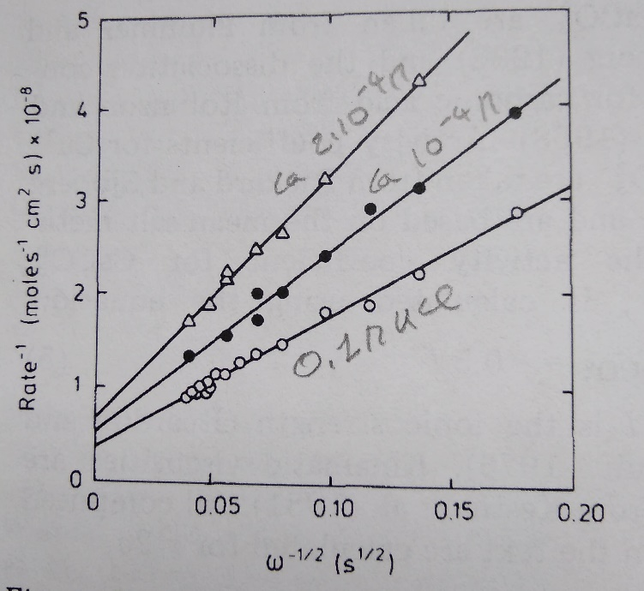
In rotating disc experiments for calcite dissolution the thickness of the DBL and the dissolution rate depends of the rotational velocity of the disc
$$R^{−1}=\frac{1.61ʋ^{1/6}}{D^{2/3}C_{eq}ɷ^{1/2}}+\frac{1}{k_{C}c_{eq}}$$
where ɷ is the angular velocity of the disc
The rate of dissolution increases as increasing the angular velocity of the disc
Carrara marble at pH=8.4
Sjöberg and Rickard, Chem. Geol. 49, 405

Slide 6
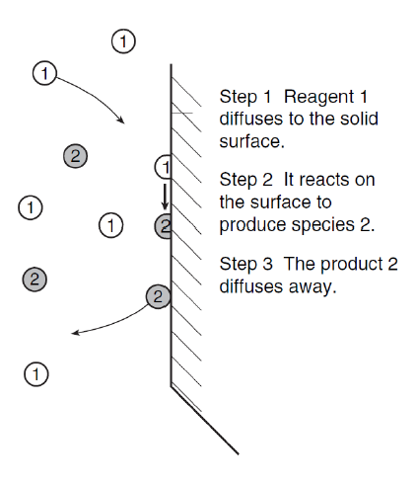
In summary:
for the dissolution process the rate of the chemical reaction will be proportional to the chemical potential difference (1-Ω) between the concentration of the dissolving salt at the interface and the concentration of the salt in equilibrium with the solid
Ca²⁺, Mg²⁺, SO₄²⁻
The surface area of the dissolving solid and the hydrodynamics of the dissolution environment will be the dissolution rate-controlling factors in natural systems.

Slide 7
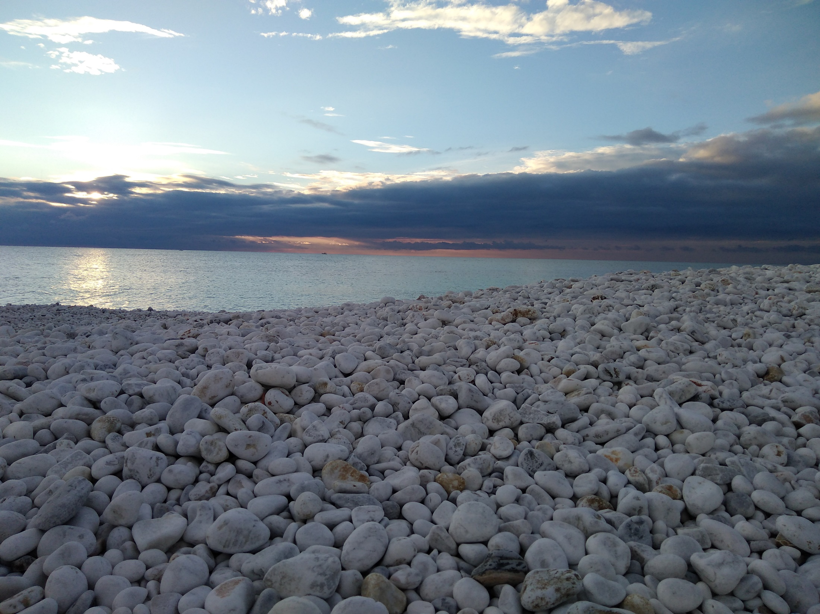
The study area. Marina di Pisa (Pisa, Italy) marble pebble beach
Pebbles are mostly constituted by calcite
CaCO₃ | ~ 98%
CaMg(CO₃)₂ | 1,76%
MgO | 1,32% mol
SiO₂ | 0,71%
Sr | 114-160 ppm
Residuo | 1,37%
Dimensione grani | 100-800 µm

Slide 8
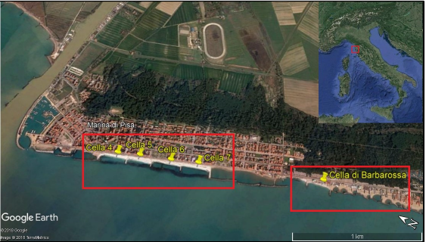
Surface seawater samples were collected in five sites close to the shoreline during three different surveys (June 2016, October 2016, February 2017)
Arno River
Ligurian Sea

Slide 9
Marina di Pisa seawater is supersaturated with calcite and should not dissolve pebbles
October 2016
February 2017
Supersaturated (precipitation)
Undersaturated (dissolution)

Slide 10
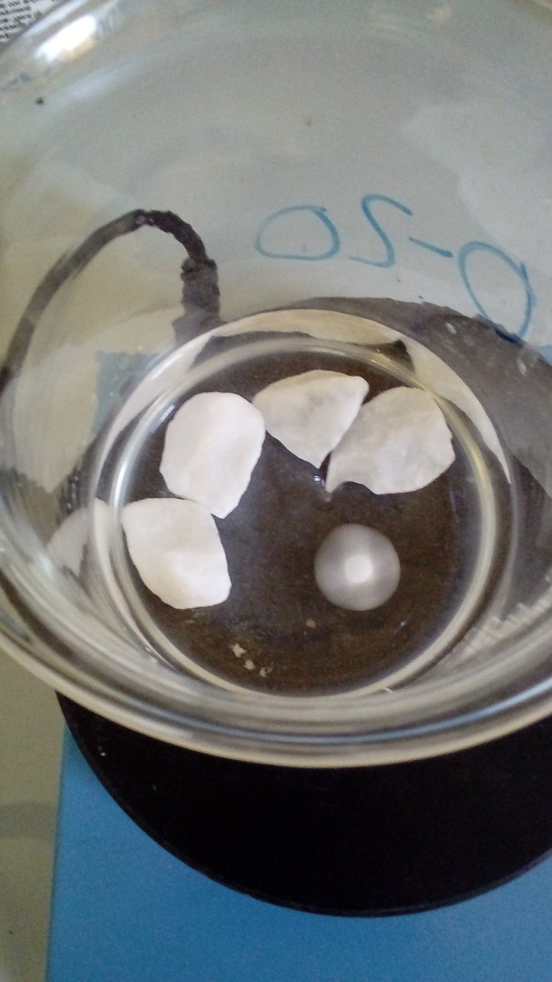
Pebbles of different size were used for simple dissolution experiments in seawater at ambient temperature on a magnetic stirrer
date | start | day 1 | day 3 | day 10
no stirring
pH | 8.2 | 8.2 | 8.2 | 8.2
stirring
pH | 8.2 | 8.1 | 7.8 | 7.5
calcite Ω | 3.16 | 1.99 | 0.39 | 0.08
Log | +0.5 | +0.3 | -0.4 | -1.1
gently stirring
In systems open to atmosphere and under stirring pH significantly decreases with time and seawater becomes undersaturated with calcite
calcite is dissolving

Slide 11
Surface seawater chemistry. Preliminary data
February, 2017
Increasing dissolution?
October, 2016
Conservative mixing patterns ?
7
5
6
Freshwater admixing?
4
7
5
Chemical changes influence the (1-Ω) potential, driving calcite dissolution rate

Slide 12
Concluding remarks
Heterogeneous dissolution reactions for calcite, the major constituent of marble pebbles, follow a mixed kinetics regime with a non-linear response to undersaturation
In this regime the speciation of surface sites and chemical diffusion at the solid-seawater interface affect reaction kinetics
A stirring and surface area dependence for the dissolution rate is reported: mechanical erosion hence henances dissolution
Significant chemical changes in major ion concentrations are observed in seawater along the Marina di Pisa pebble beach, possibly reflecting both mixing and dissolution processes. Such chemical changes have a complex chemical control on the pebble dissolution rate
Hydrodynamics and seawater chemistry are key parameters to be investigated in planning coastal management using marble pebble

