Slide 1
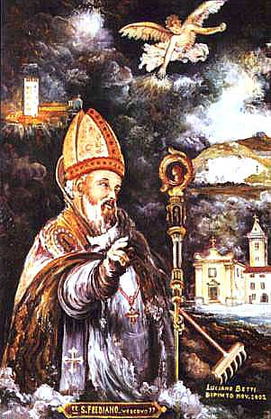
From the beginning of the Bronze Age to the San Frediano miracle: hydrological variability of the Northern Tuscany in the last 5000 cal ka BP
Giovanni Zanchetta^{1,2}, Monica Bini^{1,2}, Nicola Vivoli¹, Ilaria Isola², Eleonora Regattieri^{1,3}, Russell N. Drysdale⁴, Petra Bajo⁴, John Hellstrom⁴
¹University of Pisa, ²INGV, Rome, ³IGG-CNR, Pisa, ⁴University of Melbourne
Dati prodotti all’interno del progetto: ”Climate and alluvial events in Versilia: integration of Geoarcheological, Geomorphological, Geochemical data and numerical simulations” (Leader M. Bini)

Slide 2
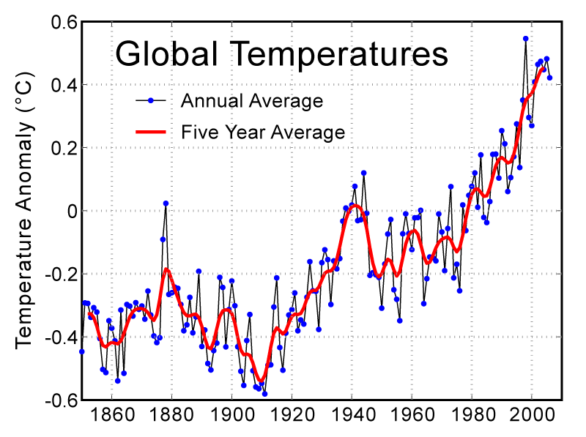
(Harris, et al. 2006. Journal Geophysical Research 111: D12106)

Slide 3
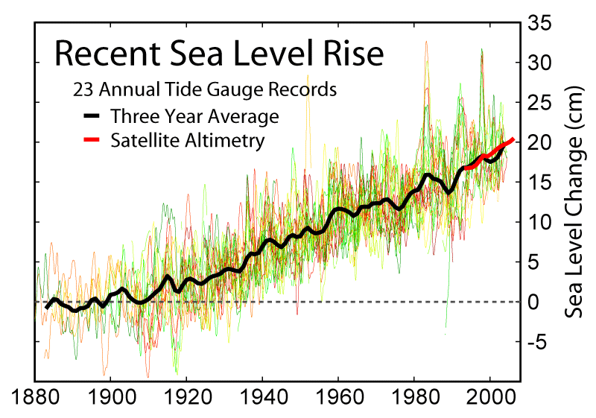

Slide 4
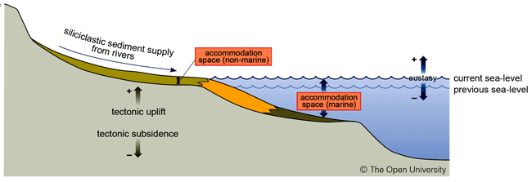
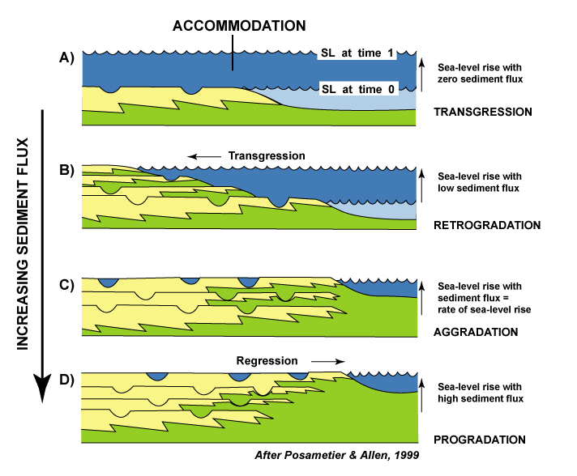
The position of the coastal line depends on several factors
Sediment flux is an important parameter for determining transgression/retrogradationa/aggradation/progradation.

Slide 5
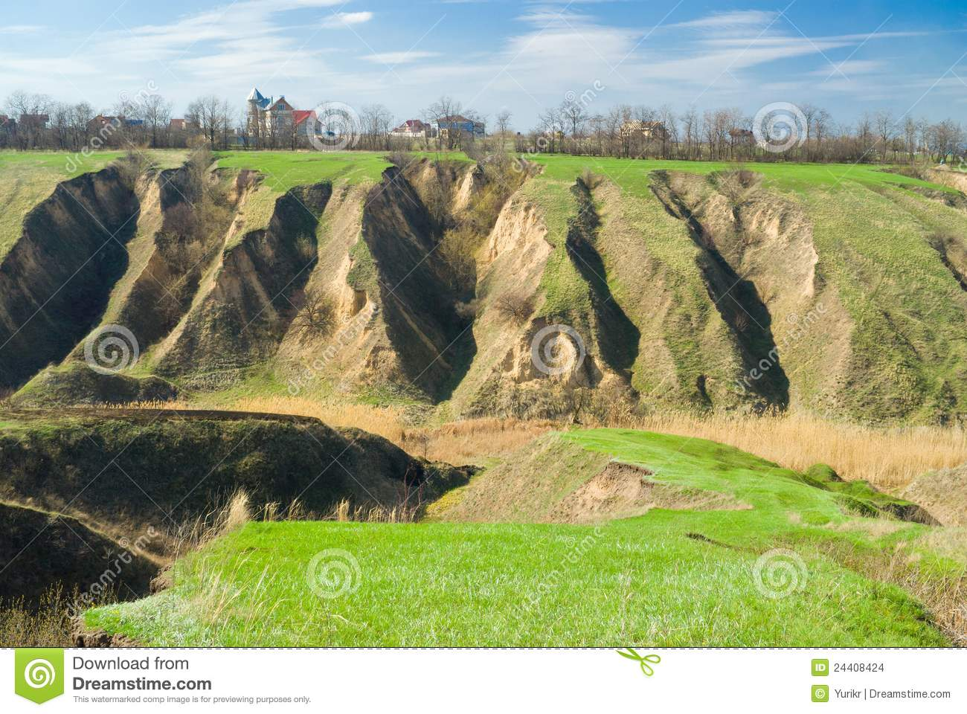
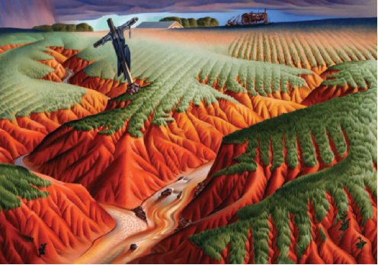
Sediment flux depends on erosion in the catchment and depends on climate condition and land use (human impact).
It is of paramount importante to define the local/global scale changes in climate to understand changes in sediment flux.
Crucified Land, Alexandre Hogue (1898–1994)

Slide 6
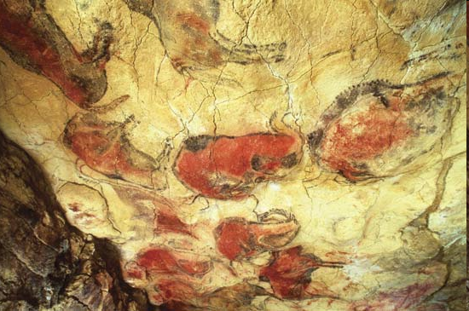
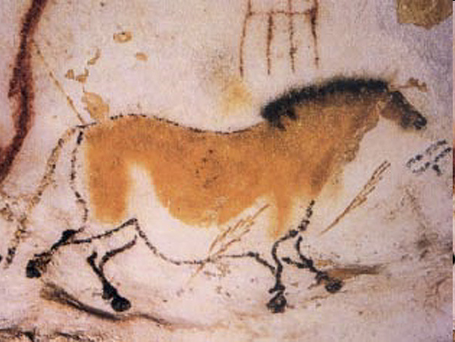
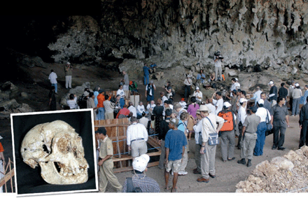
(Altamira, Spain)
(Lescaoux, France)
Caves are significant environments for preserving a record of past human and faunal occupations, with major implications for evolution…
Liang Bua, Flores, Indonesia
(Morwood et al. 2004 Nature)

Slide 7
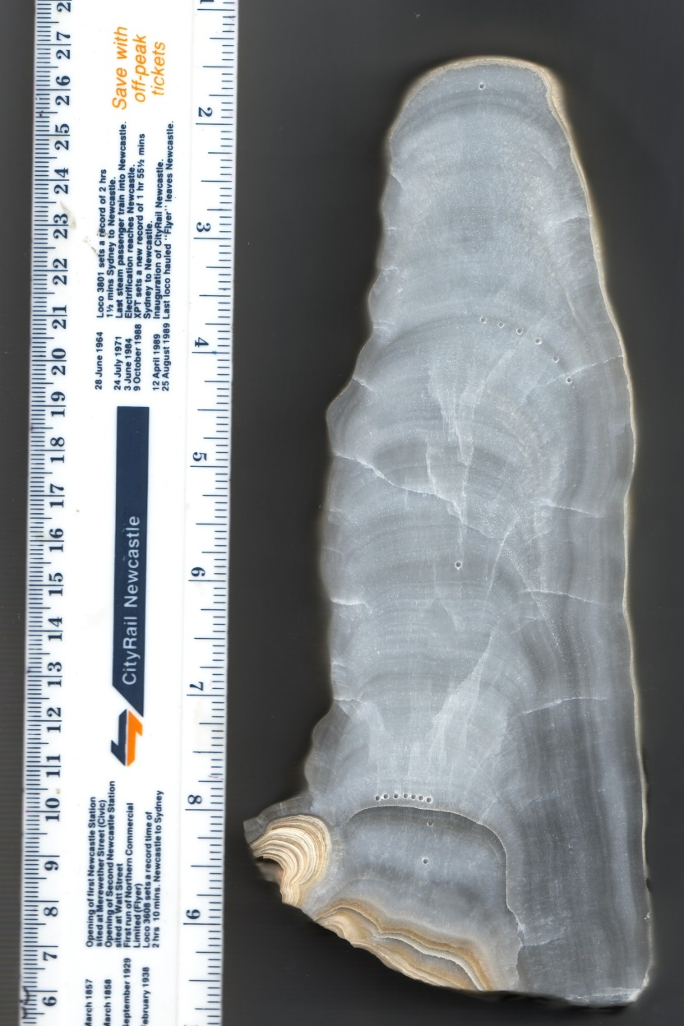
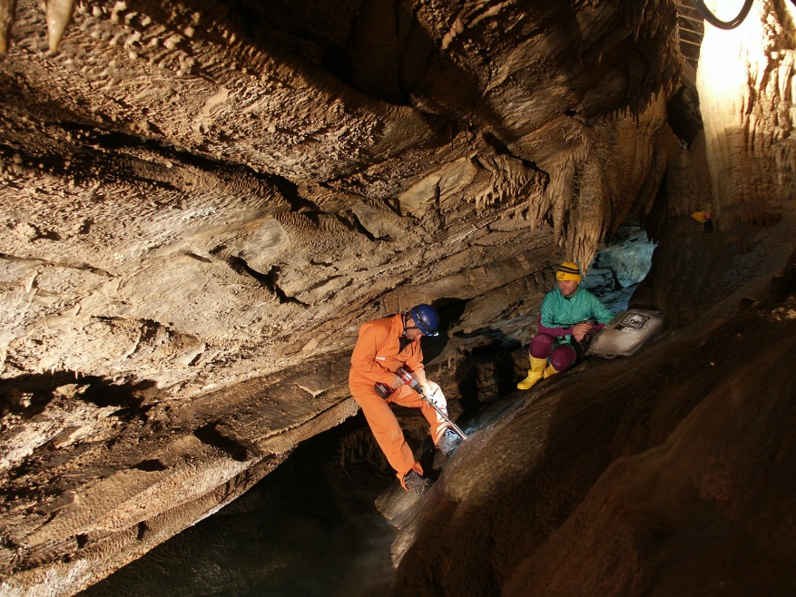
..but they also contain carbonate mineral deposits (called speleothems) that can yield vital information on Earth’s climate
Drilling flowstone cores in Corchia,
Italy (photo L. Cesari)
Cross section of a Holocene stalagmite from Corchia Cave, Italy (Sample CC27)

Slide 8
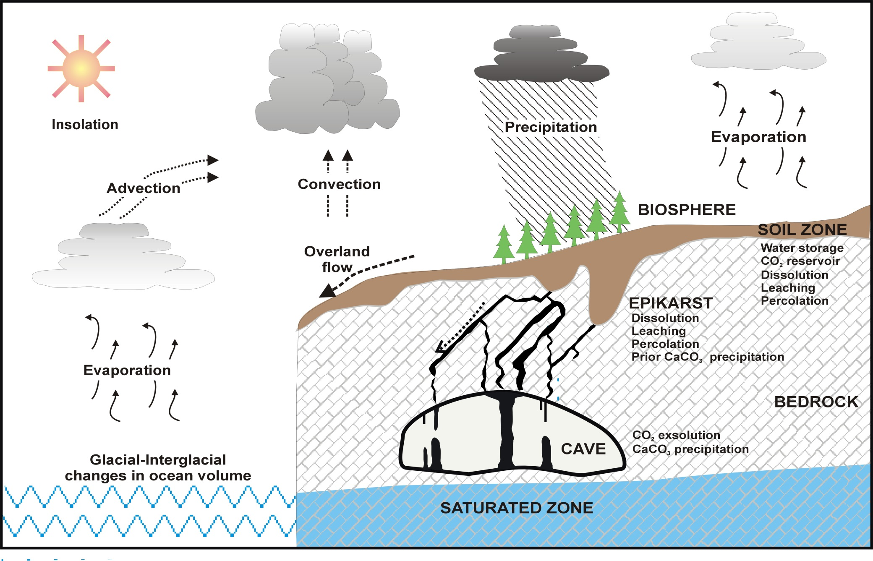
Cave concretions are part of the hydrological cycle and then they can
be potentially suitable for collecting information on hydrological changes.

Slide 9
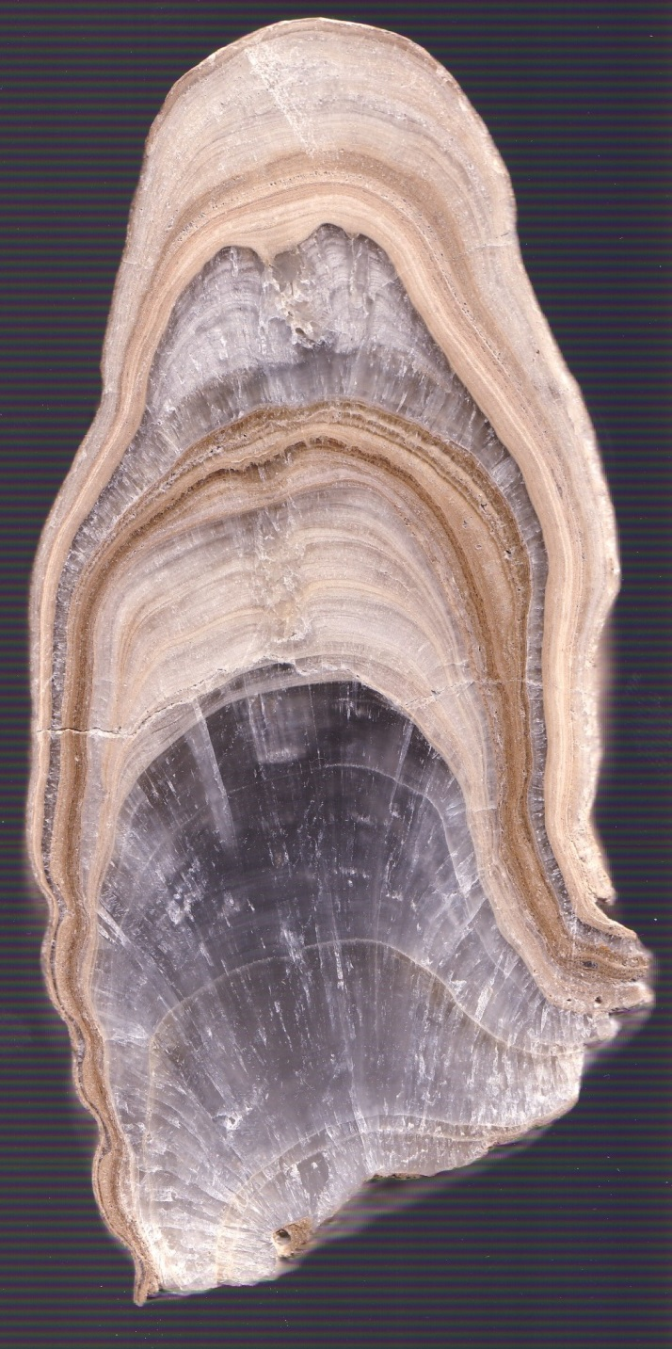
Speleothem properties
Properties Potential proxies
Age & growth Periods of effective moisture, >0 °C
Morphology Palaeohydrology
O isotopes Temperature Rainfall patterns
C isotopes: Biological activity,Palaeohydrology
Fluorescence: Palaeohydrology, Temperature
Trace element: Biological activity isotope ratios Dust flux PalaeohydrologyPalaeo-volcanism
2 cm

Slide 10
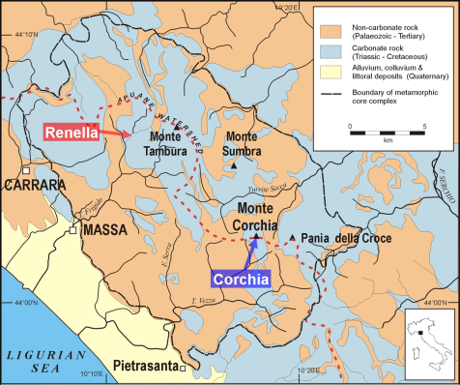

Slide 11
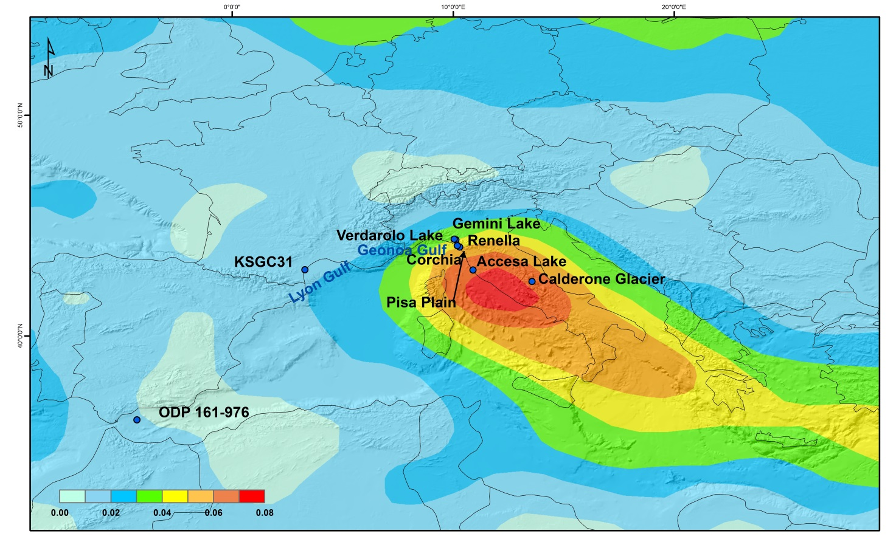
The figure shows the density track of winter storms according to ERA-interim 1989–2009. Numerical values (number of cyclones/deg2) represent the average spatial density of cyclone centers in the winter season. Only cyclones with a minimum of 1 day duration and 5 hPa depth with respect to the background are included (modified after Lionello et al., 2012, by Isola et al., 2018).

Slide 12
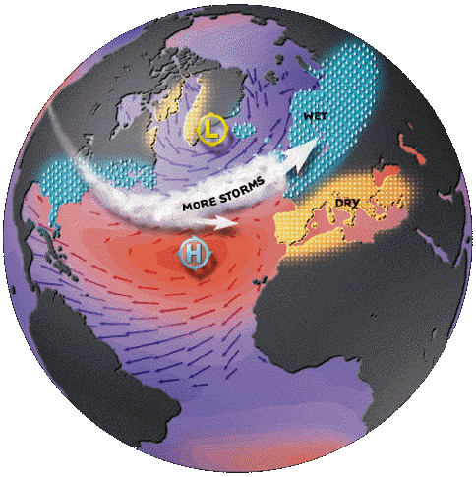
NAO +
wet

Slide 13
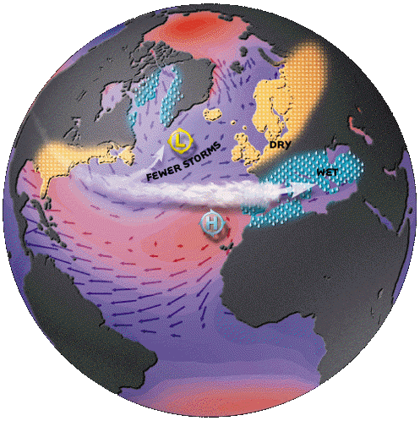
NAO -
dry

Slide 14
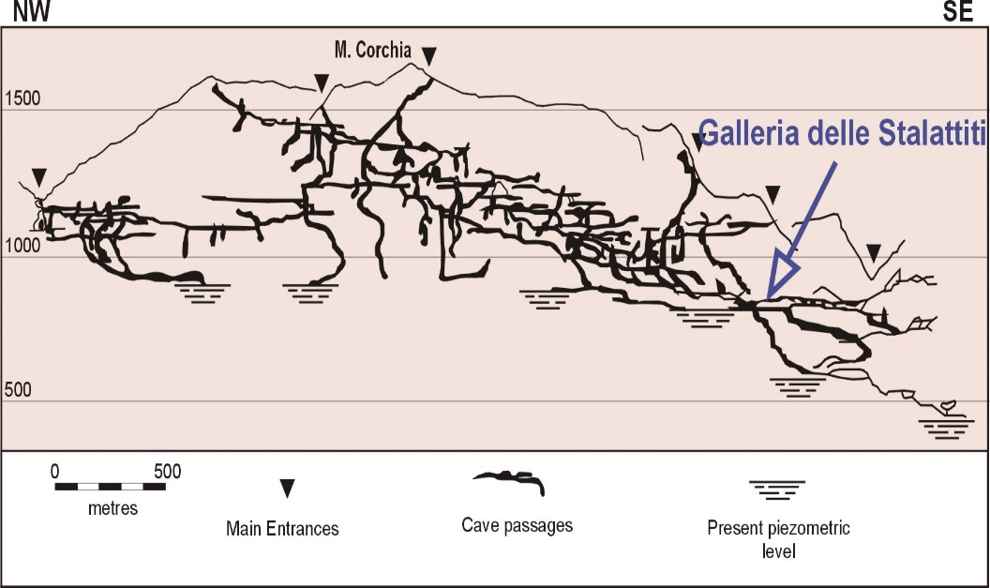
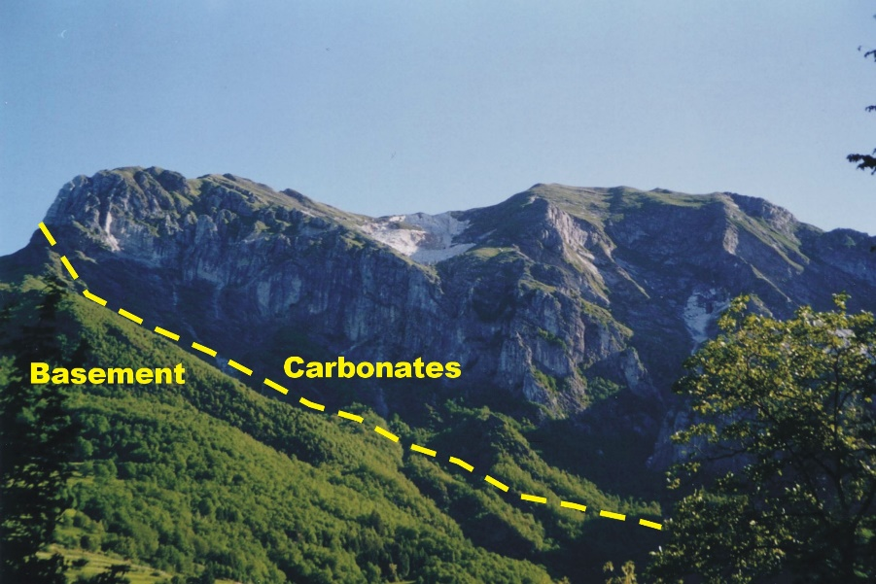
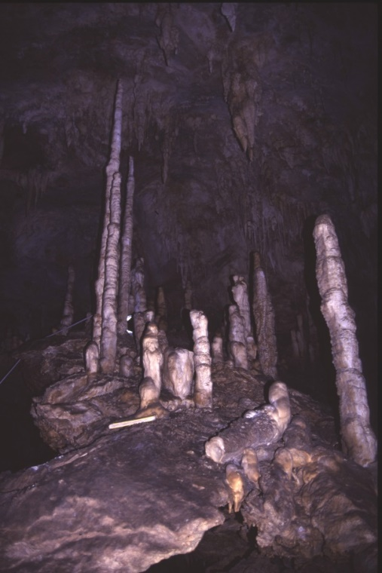
ANTRO DEL CORCHIA CAVE:
The “Galleria delle Stalattiti”
Stalagmite CC27
(Isola et al., 2018)
A deep chamber (ca 400 m below
the surface) with a very stable
environment.

Slide 15
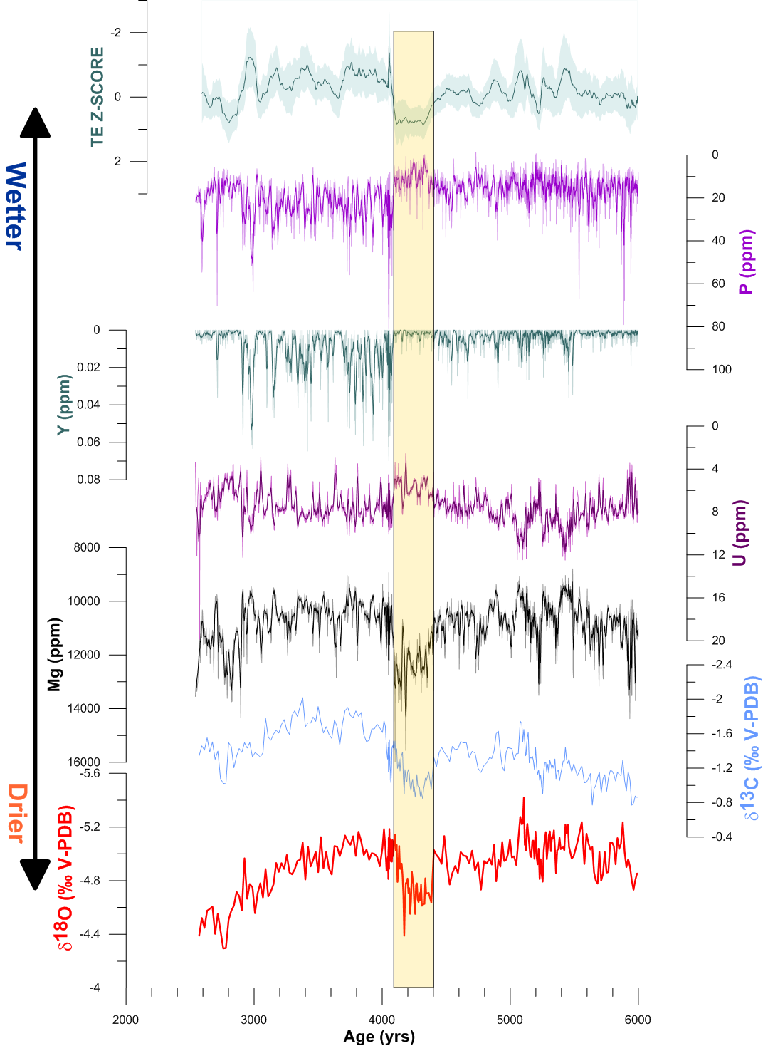
The 4.2 cal ka BP «megadrought»
Many geochmical indicators (stable isotopes, trace elements, organic matter florescence) indicate a prolonged and unusual drier conditions over the Apuan Alps between ca. 4.4 and 4.0 cal ka BP.
An additional drier period seems to be present between 2.8 and 2.6 cal ka BP.
Isola et al. 2018 Climate of The Past Discussion

Slide 16
«Megadrought!!»
Multi-proxy stack display of older, low resolution and more recent Mediterranean westerlies paleoclimate proxy data for 4.2-3.9 ka BP megadrought (and Alpine flooding), with the high-resolution proxies at Mawmluh Cave, India, and Mt. Logan, Yukon. Bars are proxy uncertainty (at two standard deviations) dating. Grey vertical band indicates ca. 300-year period of collapse, abandonment and habitat tracking in eastern Mediterranean and west Asia synchronous with megadrought (H. Weiss 2016).

Slide 17
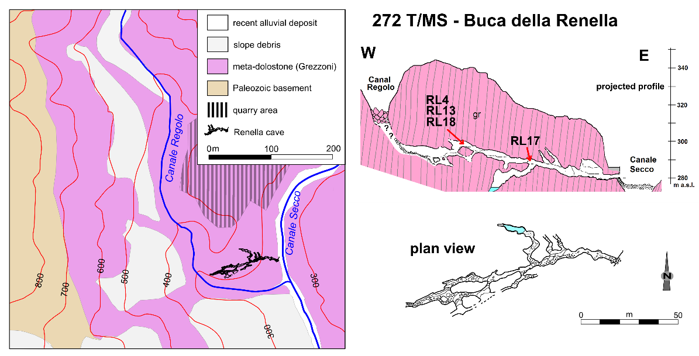
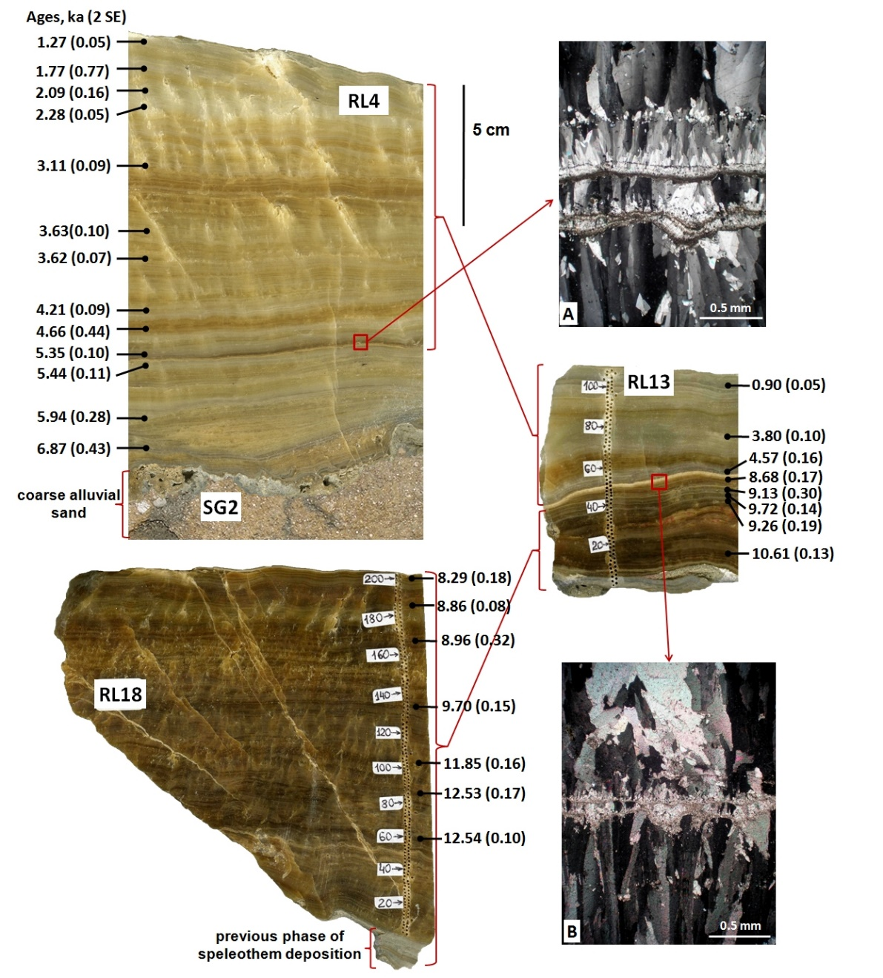
Renella Cave
The peculiar morphology of the cave allows recording exceptional flooding event in the form of thin sandy layers embedded within flowstone deposition
Zornhiak et al., 2011 QSR

Slide 18
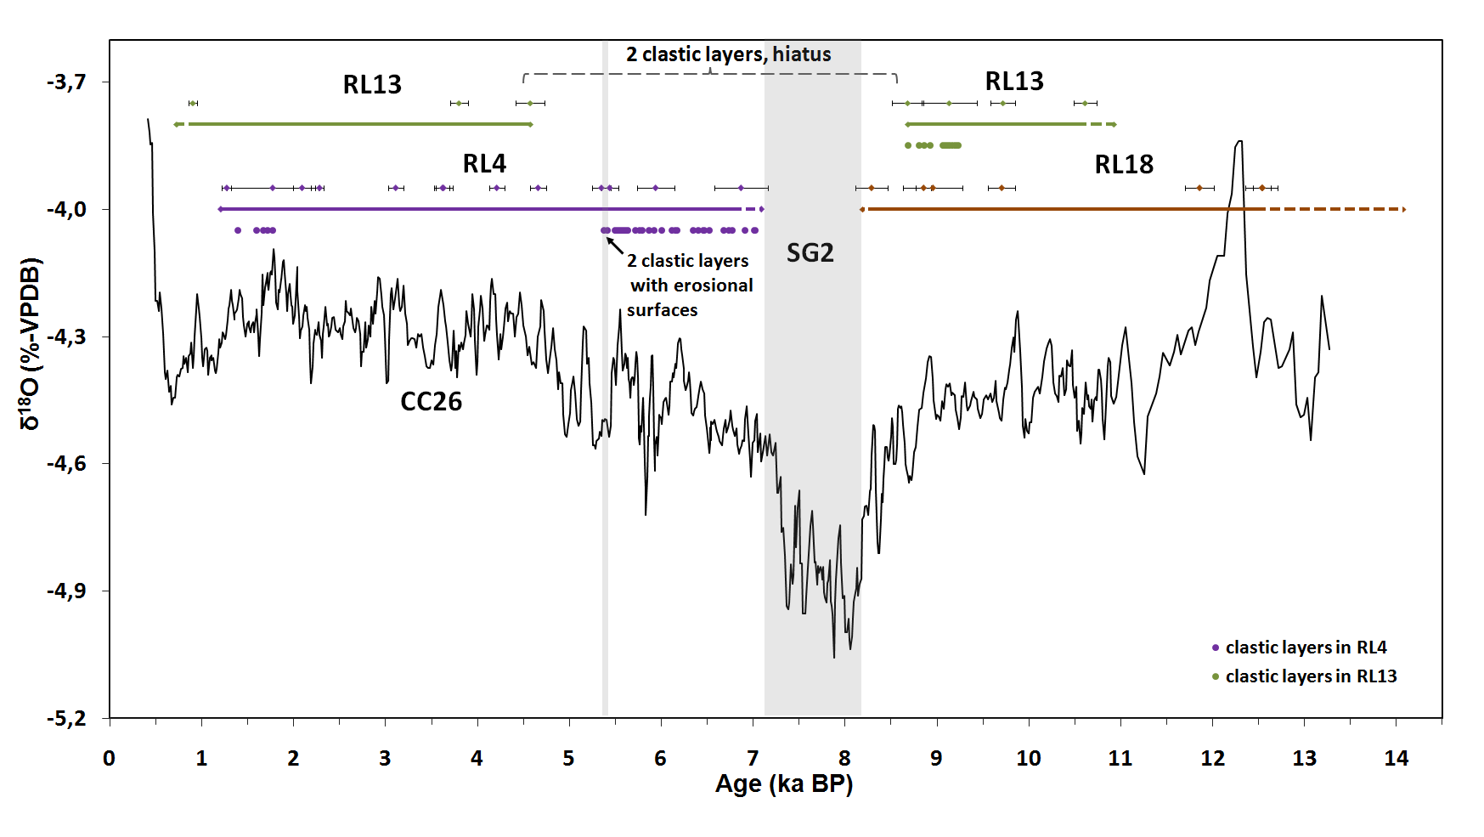
Drier
Zornhiak et al., QSR
Wetter
The deposition of the clastic layer at Renella is (within age errors) perfectly
in agreement with the phase of lower oxygen isotopes values in CC26.

Slide 19
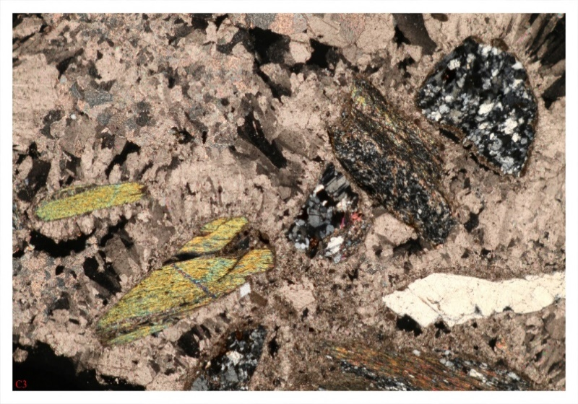
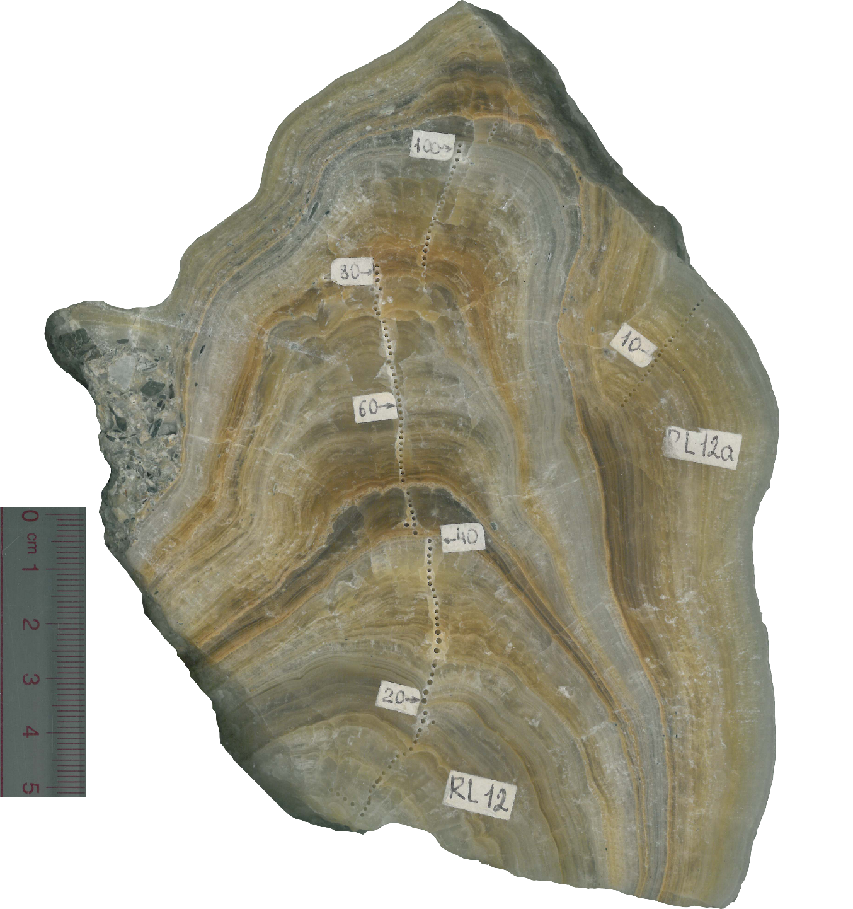
We are working on the climate and flooding events in the last 2000 yr.
Stalagmite RL12

Slide 20
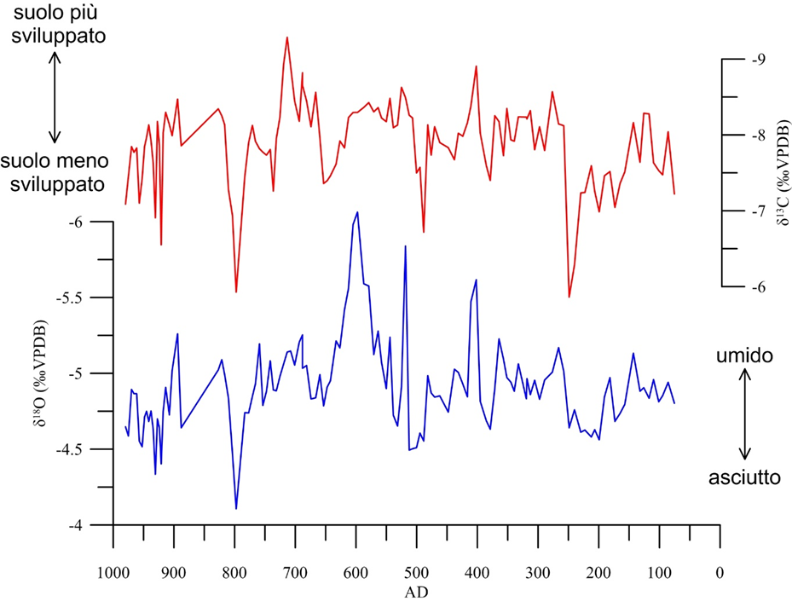
Rotta della Cucca (Diluvium di Paolo Diacono)
San Frediano
Very wet period

Slide 21
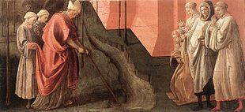
Frediano di Lucca (Irlanda, dopo il 500 – Lucca, 18 marzo 588) è stato un vescovo irlandese. Fu vescovo di Lucca dal 566 alla sua morte. Le fonti agiografiche ce lo descrivono come un monaco irlandese, figlio del re dell'Ulster Ultach (Ultonius). Educato nei monasteri irlandesi, ordinato presbitero decise di recarsi a Roma in pellegrinaggio. Sulla via del ritorno decise di ritirarsi in eremitaggio in un anfratto nel Monte Pisano. La sua fama di santità spinse i cittadini di Lucca ad eleggerlo Vescovo tra il 560 e il 566. Papa Gregorio I riferisce di un miracolo narratogli dal vescovo di Luni (diocesi allora contigua a Lucca); mentre i lucchesi si affaticavano invano per deviare il corso del Serchio, che correva troppo vicino alla città e con le inondazioni causava danni continui, Frediano, dopo che era stato richiesto il suo aiuto, si avviò sul percorso che il fiume avrebbe dovuto seguire tracciando un solco con un rastrello e le acque lo seguirono docilmente. Nella realtà San Frediano nel 575 fece aprire una nuova bocca del Serchio a Migliarino. Forse l'allusione al rastrello nasconde uno strumento usato per tracciare il nuovo corso delle acque del Serchio.
SAN FREDIANO E IL MIRACOLO «NECESSARIO»
San Frediano devia le acque del Serchio, Filippo Lippi tempera su tavola, Galleria degli Uffizi

Slide 22
Late Antique Little Ice Age and «The San Frediano Miracle»
Eurasian summer temperature variability. a,b, Reconstructed temperatures from the Russian Altai (a) and the European Alps5 (b), with blue and red squares indicating positive and negative annual extremes (>2 standard deviations), respectively. Grey background shadings denote reconstruction uncertainty after 80-year low-pass filtering. c,d, Ice-core-derived global estimates of volcanic (GVF; dark grey; c) and total solar irradiance17 (TSI; light dashed grey; d) forcing. Black dashed lines refer to the long-term reconstruction mean of the Common Era.
Butgen et al., 2016 NG

Slide 23
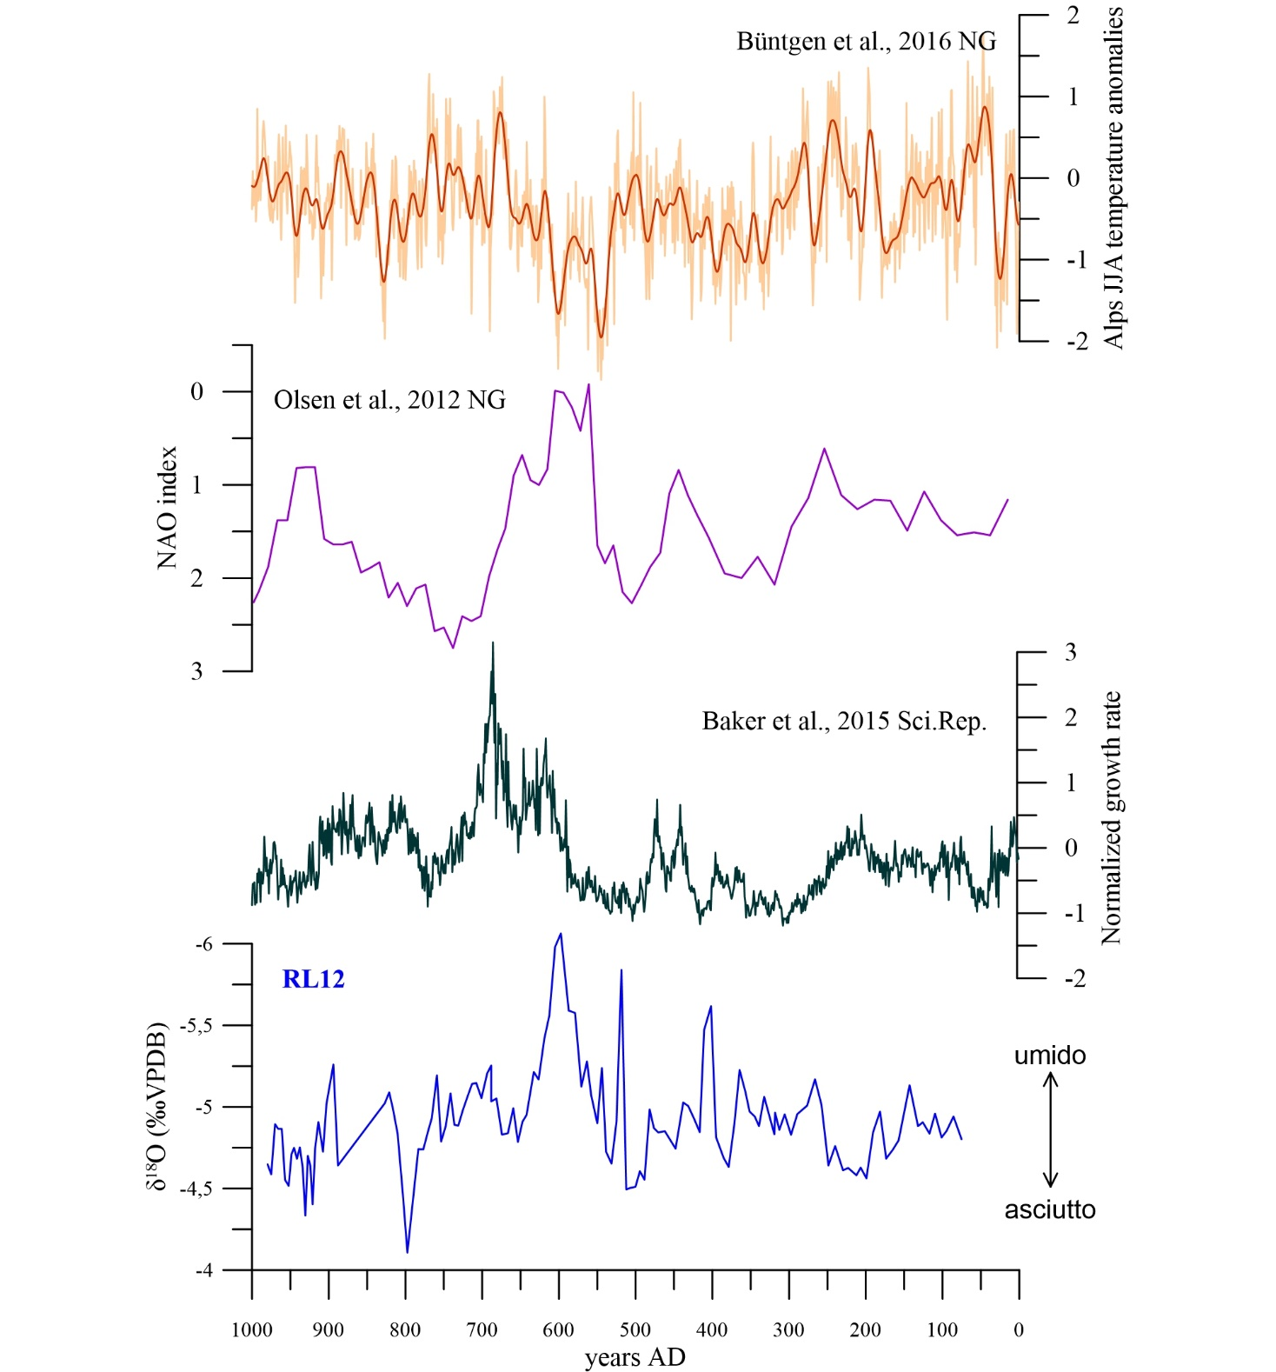
The climate reconstruction indicate that the wet period between ca. VI and V century is consistent with particularly pronounced Negative NAO, correspond to reduction in temperature in Central Europe.

Slide 24
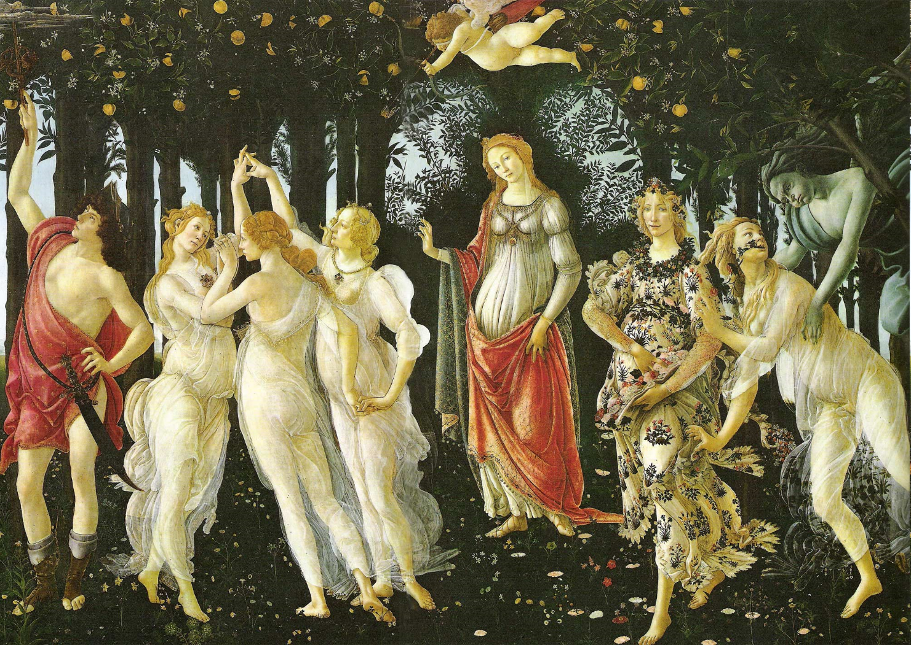
Crossing archaeological, stratigraphic, geochemical and documentary data is one of the most intriguing aspect of our project.
Next: to study coastal evolution in relation to the identified climatic phases

